Slide 1

Videogame Playability analysis with Pyspark using players reviews
Big Data Computing-Prof. Gabriele Tolomei
Final project A.Y. 2022/23
MSc in Computer Science
De Sio Ilaria- Matr. 2064970

Slide 2
01 Introduction & Dataset
A brief presentation of the addressed problem and the context
Project Overview
02 Data pre-processing
Data Cleaning, Data Exploration and Text-processing
03 Topic modeling
Content Analysis and Document Coherence score
04 Machine Learning
Prediction hypothesis within the dataset

Slide 3
Introduction
No Man’s sky
Jupiter is the biggest planet in the Solar System
Research Paper
”A Data-Driven Approach for video Game playability Analysis Based on Players reviews”
Framework of Paavilainen
Functionality, Gameplay and Usability
Notes:
-parla del gioco e dici perché è un caso di studio unico -parla del paper di come è strutturato -parla del framework con esempi

Slide 4
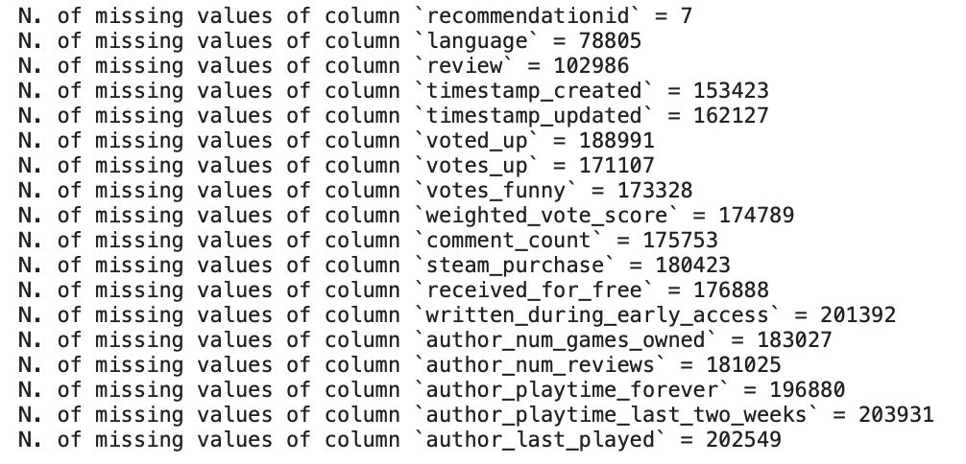
Data Cleaning
3/4
NULL VALUES
1/4
VALID VALUES
64.257 rows

Slide 5


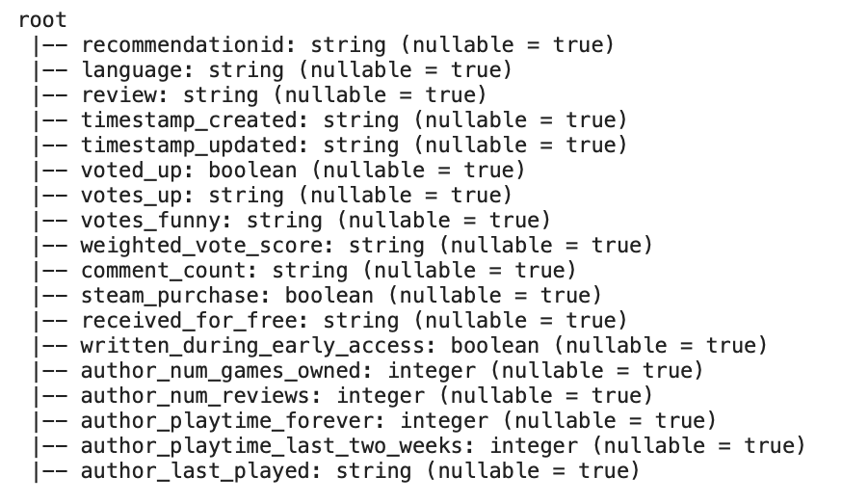

Dataset Description
Shape
Valid values
Initially is 273.742 rows
After Data cleaning ¼ of the dataset only 64.257 rows
Columns
Short reviews
18 columns as in the picture
Duplicates short reviews such as ‘nice game’ ‘good game’

Slide 6
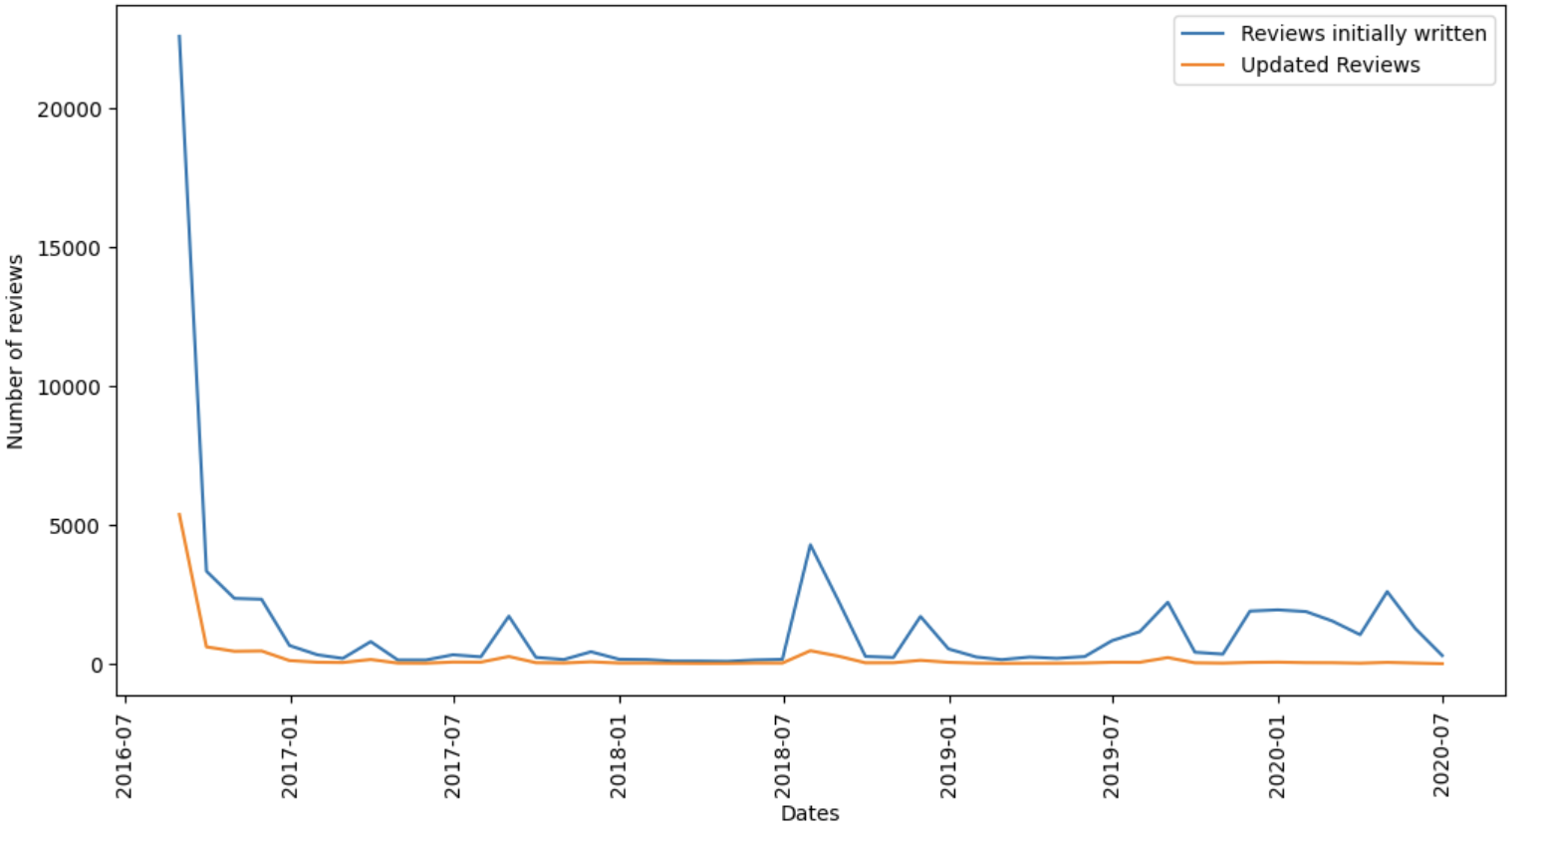
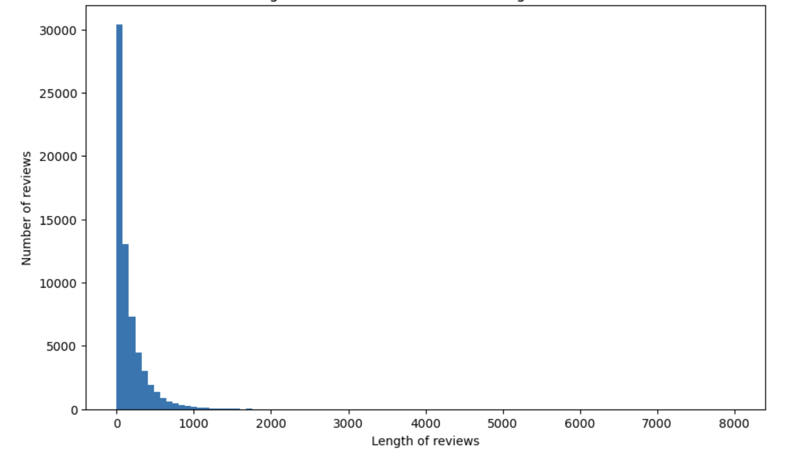
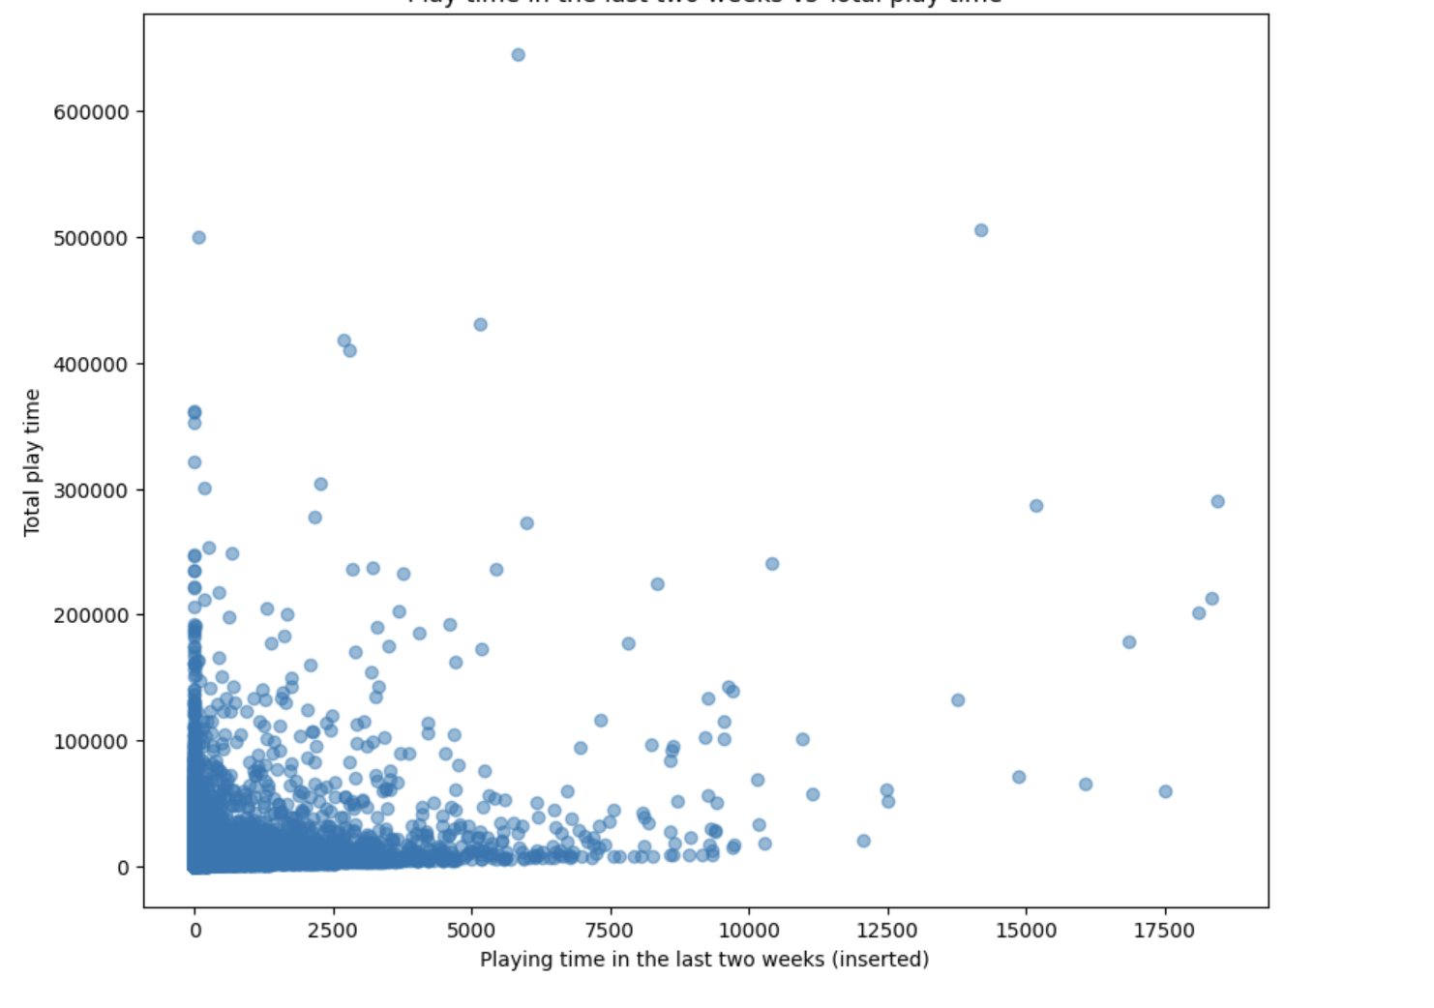
Data exploration
Number of reviews written and updated over time
Distribution of length of reviews
Play time in last two weeks vs total

Slide 7
1
Text-processing
2
Topic Modeling
Feature Extraction
3
LDA and Coherence Score
4
Word Cloud
5
Topic choice

Slide 8
Topic Modeling
LDA
Jupiter
Mars
Saturn
Neptune
Jupiter is the biggest planet of them all
Despite being red, Mars is actually a cold place
Saturn is a gas giant and has several rings
Neptune is the farthest planet from the Sun

Slide 9
Text-processing
Divides a text into smaller units called 'tokens’, such as words, phrases or other meaningful units.
Reduces words to their base or dictionary form, lemmas. Common words like "the," "and," or "is”.
Tokenization
Lemmatization, stop-words
N-Grams
Are contiguous sequences of N items, such as Unigrams, Bigrams.
Part-of-Speech(POS)
Filtering
Assign grammatical labels or tags to words in a text based on their syntactic category (NN=noun, VB=verb, JJ=adjective).
Remove DT,PRP,CC and merge all N-Grams.

Slide 10
Feature Extraction
TF-IDF
PCA
A statistical metric employed to assess the significance of a word within a document in a corpus that that combines two key concepts:
Term frequency (TF),
Inverse document frequency (IDF).
Principal Component Analysis (PCA) is a statistical technique used for dimensionality reduction.

Slide 11
Technology Infographics
Saturn
It’s a gas giant and has several rings
Jupiter
Jupiter is the biggest planet of them
Neptune
It’s the farthest planet from the Sun
Mars
Despite being red, Mars is cold
Mercury
It’s the closest planet from the Sun
Earth
Earth is the third planet from the Sun

Slide 12
Technology Infographics
Mars
Jupiter
Despite being red, Mars is actually cold
25%
35%
Jupiter is the biggest planet of them all
Earth
Neptune
Earth is the third planet from the Sun
10%
40%
Neptune is the farthest planet from the Sun

Slide 13
Technology Infographics
Jupiter
Saturn
Jupiter is the biggest planet of them all
It’s a gas giant and has several rings
Mars
Neptune
Despite being red, Mars is actually cold
It’s the farthest planet from the Sun
Earth
Mercury
Earth is the third planet from the Sun
It’s the closest planet from the Sun

Slide 14
Technology Infographics
Jupiter
Saturn
Jupiter is the biggest planet of them all
03
04
It’s a gas giant and has several rings
Mars
02
05
Neptune
Despite being red, Mars is actually cold
It’s the farthest planet from the Sun
Earth
01
06
Mercury
Earth is the third planet from the Sun
It’s the closest planet from the Sun

Slide 15
Technology Infographics
1
6
Jupiter
Saturn
Jupiter is the biggest planet of them all
It’s a gas giant and has several rings
2
5
Mars
Neptune
Despite being red, Mars is actually cold
It’s the farthest planet from the Sun
3
4
Earth
Mercury
Earth is the third planet from the Sun
It’s the closest planet to the Sun

Slide 16
Technology Infographics
Jupiter
Mercury
Jupiter is the biggest planet
It’s the closest planet of the Sun
Neptune
Earth
It’s the farthest planet from the Sun
It’s the third planet from the Sun
Saturn
Mars
It’s a gas giant and has several rings
Despite being red, it’s a cold place

Slide 17
Technology Infographics
Jupiter
Mercury
Jupiter is the biggest planet of them all
It’s the closest planet of the Sun
Neptune
Earth
It’s the farthest planet from the Sun
It’s the third planet from the Sun
Saturn
Mars
It’s a gas giant and has several rings
It’s actually a cold place

Slide 18
Demo

Slide 19
Future goals
The planet’s name has nothing to do with the liquid metal since it was named after the Roman messenger god, Mercury
Mercury is the closest planet to the Sun and the smallest one in the Solar System—it’s only a bit larger than the Moon
Venus has a beautiful name and is the second planet from the Sun. It’s terribly hot—even hotter than Mercury
Its atmosphere is extremely poisonous. It’s the second-brightest natural object in the night sky after the Moon

Slide 20
Technology Infographics
Jupiter
Saturn
Jupiter is the biggest planet of them all
It’s a gas giant and has several rings
Mars
Neptune
Despite being red, Mars is actually cold
It’s the farthest planet from the Sun

Slide 21
Technology Infographics
Jupiter
Earth
Jupiter is the biggest planet
Earth is where we live on
Mars
Neptune
Despite being red, it’s cold
It’s far away from Earth
Saturn
Venus
It has several rings
It has a beautiful name

Slide 22
Technology Infographics
Neptune
Earth
It’s the farthest planet from the Sun
It’s the third planet from the Sun
Jupiter
Mercury
Jupiter is the biggest planet of them all
It’s the closest planet of the Sun

Slide 23
Technology Infographics
Mercury
It’s the closest planet of the Sun
Earth
It’s the third planet from the Sun
Mars
Despite being red, Mars is a cold place

Slide 24
Technology Infographics
Jupiter
Jupiter is the biggest planet of them all
Earth
2
4
It’s the third planet from the Sun
Neptune
It’s the farthest planet from the Sun
1
3
5
Mars
It’s actually a cold place
Saturn
It’s a gas giant and has several rings

Slide 25
Technology Infographics
Jupiter
Mercury
Jupiter is the biggest planet of them all
It’s the closest planet of the Sun
Neptune
Earth
It’s the farthest planet from the Sun
It’s the third planet from the Sun
Saturn
Mars
It’s a gas giant and has several rings
It’s actually a cold place

Slide 26
Technology Infographics
Jupiter
Mercury
Jupiter is the biggest planet of them all
It’s the closest planet of the Sun
Neptune
Earth
It’s the farthest planet from the Sun
It’s the third planet from the Sun
Saturn
Mars
It’s a gas giant and has several rings
It’s actually a cold place

Slide 27
Technology Infographics
Neptune
Venus
It’s the farthest planet from the Sun
It’s the closest planet of the Sun
Jupiter
Earth
Mars
Jupiter is the biggest planet of them all
It’s the third planet from the Sun
Despite being red, it’s actually a cold place

Slide 28
Flat Startup Infographics
01
02
MERCURY
NEPTUNE
The planet’s name has nothing to do with the liquid metal
Neptune is the farthest planet from the Sun
03
04
VENUS
EARTH
It has a beautiful name and is the second planet
Earth is the planet where we all live on

Slide 29
Technology Infographics
Neptune
It’s the farthest planet from the Sun
Jupiter
Earth
Jupiter is the biggest planet of them all
It’s the third planet from the Sun
Mars
Mercury
Despite being red, it’s actually a cold place
It’s the closest planet from the Sun

Slide 30
Technology Infographics
1
3
5
Jupiter is the biggest planet of them all
Saturn is a gas giant and has several rings
Mercury is the closest planet of the Sun
2
4
6
Neptune is the farthest planet from the Sun
Earth is the third planet from the Sun
Despite being red, it’s actually a cold place

Slide 32
Technology Infographics
1
Jupiter
Jupiter is the biggest planet of them all
2
Mars
Despite being red, it’s actually a cold place
3
Saturn
Saturn is a gas giant and has several rings
4
Mercury
Mercury is the closest planet to the Sun
5
Neptune
Neptune is the farthest from the Sun

Slide 33
Technology Infographics
Jupiter
Neptune
Saturn
Mars
Mercury
Earth
Jupiter is the biggest planet
Neptune is the farthest planet
Saturn has several rings
Mars is actually a cold place
It’s the closest planet of the Sun
Earth is the third planet to the Sun

Slide 34
Topic Modeling
Jupiter
Saturn
Jupiter is the biggest planet of them all
It’s a gas giant and has several rings
Neptune
Mercury
It’s the farthest planet from the Sun
It’s the closest planet of the Sun

Slide 35
Technology Infographics
Mercury
It’s the closest planet of the Sun
Jupiter
Neptune
Jupiter is the biggest planet of them all
It’s the farthest planet from the Sun
Saturn
Mars
It’s a gas giant and has several rings
It’s actually a cold place
Earth
It’s the third planet from the Sun

Slide 36
Technology Infographics
Jupiter
Mercury
Jupiter is the biggest planet of them all
It’s the closest planet of the Sun
Neptune
Earth
It’s the farthest planet from the Sun
It’s the third planet from the Sun
Saturn
Mars
It’s a gas giant and has several rings
Despite being red, it’s actually a cold place

Slide 37
Technology Infographics
Jupiter
Saturn
Jupiter is the biggest planet
Saturn has several rings
Mars
Earth
Mars is actually a cold place
Earth is the the third planet
Neptune
Mercury
Neptune is the farthest planet
Mercury is the smallest planet

Slide 38
Flat Startup Infographics
01
Saturn is a gas giant and has rings
02
Its name has nothing to do with the liquid metal
03
Venus has a beautiful name and is the second planet from the Sun
04
Mercury is the closest planet to the Sun and the smallest one in the Solar System

Slide 39
Flat Startup Infographics
01
Mars
Despite being red, Mars is actually a cold place. It’s full of iron oxide dust
Mercury
02
Its name has nothing to do with the liquid metal, since it was named after the Roman messenger god
03
Venus
Venus has a beautiful name and is the second planet from the Sun. It’s terribly hot
Neptune
04
Neptune is the farthest planet from the Sun. It’s the fourth-largest by diameter

Slide 40
Flat Startup Infographics
Mars is actually a cold place
Venus has a beautiful name
Saturn is a gas giant and has rings
The biggest planet of them all
Neptune is far away from Earth

Slide 41
Flat Startup Infographics
MERCURY
MARS
VENUS
NEPTUNE
01
02
03
04
Mercury is the closest planet to the Sun and the smallest one in the Solar System—it’s a bit larger than the Moon
Despite being red, Mars is actually a cold place. It’s full of iron oxide dust, giving the planet its reddish cast
Venus has a beautiful name and is the second planet from the Sun. It’s terribly hot—even hotter than Mercury
Neptune is the farthest planet from the Sun. It’s the fourth-largest by diameter in the entire Solar System

Slide 42
Flat Startup Infographics
The planet’s name has nothing to do with the liquid metal since it was named after the Roman messenger god, Mercury
01
MERCURY
Jupiter is a gas giant and the biggest planet in the Solar System. It’s the fourth-brightest object in the sky
JUPITER
02
Venus has a beautiful name and is the second planet from the Sun. It’s terribly hot—even hotter than Mercury
03
VENUS
Neptune is the farthest planet from the Sun and the fourth-largest by diameter in the Solar System
NEPTUNE
04

Slide 43
Flat Startup Infographics
Mercury is the closest planet to the Sun and the smallest one in the Solar System—it’s only a bit larger than our Moon
MERCURY
Venus has a beautiful name and is the second planet from the Sun. It’s terribly hot—even hotter than Mercury
VENUS
Jupiter is a gas giant and the biggest planet in the Solar System. It’s the fourth-brightest object in the sky
JUPITER

Slide 44
Flat Startup Infographics
A
B
C
D
MERCURY
MARS
VENUS
NEPTUNE
Mercury is the closest planet to the Sun and the smallest one
Despite being red, Mars is actually a very cold place
Venus has a beautiful name and is the second planet
It’s the fourth-largest planet by diameter in the Solar System

Slide 45
Flat Startup Infographics
Despite being red, Mars is actually a cold place full of iron oxide dust
MARS
Mercury is the closest planet to the Sun and the smallest one
MERCURY
Venus has a beautiful name and is the second planet from the Sun
VENUS
Saturn is a gas giant and composed mostly of hydrogen and helium
SATURN

Slide 46
Flat Startup Infographics
 |  | Accuracy | Precision | Recall | F1-score
Logistic Regression
Decision Tree
Random Forest
Naïve Bayes
JUPITER
MARS
VENUS
NEPTUNE

Slide 47
Flat Startup Infographics
MERCURY
Mercury is the closest planet to the Sun and the smallest one in the Solar System—it’s only a bit larger than our Moon
Despite being red, Mars is actually a cold place full of iron oxide dust, giving the planet its reddish cast
MARS
VENUS
Venus has a beautiful name, but also a poisonous atmosphere. It’s the second planet from the Sun
Neptune is the farthest planet from the Sun. It’s the fourth-largest planet in the Solar System
NEPTUNE

Slide 48
Flat Startup Infographics
MERCURY
NEPTUNE
Mercury is the closest planet to the Sun and the smallest one in the Solar System—it’s a bit larger than the Moon
Neptune is the farthest planet from the Sun. It’s the fourth-largest by diameter in the Solar System
VENUS
JUPITER
The atmosphere is extremely poisonous. It’s the second-brightest natural object in the night sky after the Moon
Jupiter is a gas giant and the biggest planet in the Solar System. It was named after a Roman god

Slide 49
Flat Startup Infographics
MERCURY
MARS
NEPTUNE
VENUS
It’s the closest planet to the Sun and the smallest of them all
Despite being red, Mars is actually a cold place
Neptune is the fourth-largest planet in the Solar System
Venus has a beautiful name and is the second planet

Slide 50
Flat Startup Infographics
MERCURY
01
02
VENUS
Its name has nothing to do with the liquid metal
STEP
STEP
It has a beautiful name, but also high temperatures
SATURN
03
04
JUPITER
Saturn is a gas giant and has several rings
STEP
STEP
It’s the biggest planet in the entire Solar System

Slide 51
Before
After
50%
75%
90%
Jupiter
Venus
Neptune
Jupiter is the biggest planet in the Solar System and the fourth-brightest
Venus has a beautiful name and is the second planet from the Sun. It’s terribly hot
Neptune is the farthest planet from the Sun and the fourth-largest in the Solar System

Slide 52
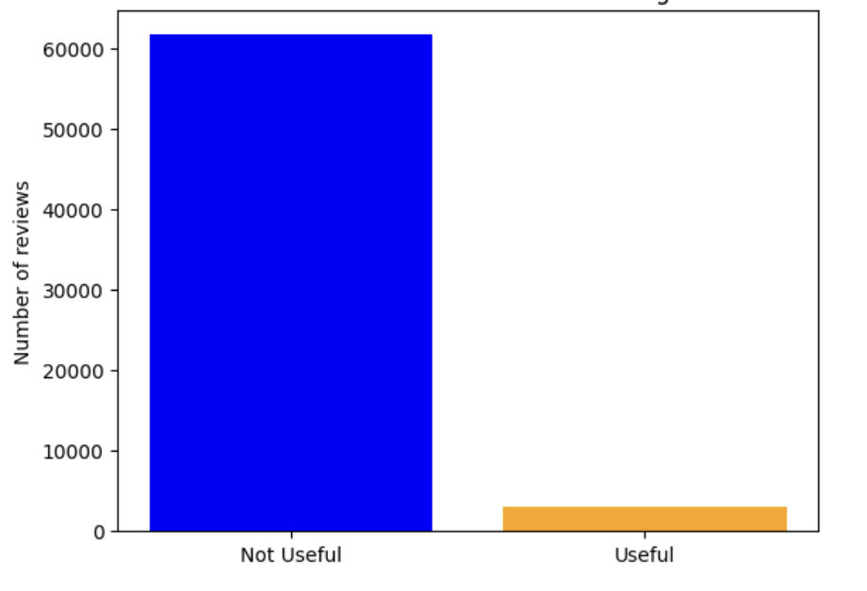
Data Balancing
After
Before

Slide 53
Flat Startup Infographics
01
It’s the closest planet to the Sun and the smallest one in the Solar System—it’s only a bit larger than the Moon
02
Venus has a beautiful name and is the second planet from the Sun. It’s even hotter than Mercury
03
Its name has nothing to do with the metal, since it was named after the Roman messenger god
04
Its atmosphere is extremely poisonous. It’s the second-brightest natural object in the night

Slide 54
Flat Startup Infographics
NEPTUNE
Neptune is the fourth-largest in the Solar System
The planet’s name has nothing to do with the liquid metal
JUPITER
EARTH
Earth is the third planet from the Sun. It’s where we all live on
Venus has a beautiful name and is the second planet from the Sun
VENUS

Slide 55
Flat Startup Infographics
NEPTUNE
Neptune is the farthest planet from the Sun and the fourth-largest by diameter in the Solar System
MERCURY
Mercury is the closest planet to the Sun and the smallest one in the Solar System—it’s a bit larger than the Moon
JUPITER
Jupiter is the biggest planet in the Solar System and the fourth-brightest object in the night sky
VENUS
Its atmosphere is extremely poisonous. It’s the second-brightest natural object in the night sky after the Moon

Slide 56
Flat Startup Infographics
MERCURY
JUPITER
01
04
Mercury is the closest planet to the Sun and the smallest
It’s the biggest planet in the Solar System
VENUS
02
03
EARTH
It’s the second-brightest natural object in the night sky
Earth is the third planet in the Solar System

Slide 57
Flat Startup Infographics
MARS
VENUS
Despite being red, Mars is actually a cold place
It has a beautiful name and is the second planet

Slide 58
Flat Startup Infographics
MERCURY
NEPTUNE
Mercury is the closest planet to the Sun and the smallest one in the Solar System—it’s only a bit larger than our Moon
Neptune is the farthest planet from the Sun. It’s the fourth-largest by diameter in the Solar System
MARS
VENUS
Despite being red, Mars is actually a cold place. It’s full of iron oxide dust, giving the planet its reddish cast
Venus has a beautiful name and is the second planet from the Sun. It’s terribly hot—even hotter than Mercury

Slide 59
Flat Startup Infographics
The planet’s name has nothing to do with the liquid metal since it was named after the Roman messenger god, Mercury
MERCURY
Mercury is the closest planet to the Sun and the smallest one in the Solar System—it’s a bit larger than the Moon
MERCURY
Venus has a beautiful name and is the second planet from the Sun. It’s terribly hot—even hotter than Mercury
VENUS
Its atmosphere is extremely poisonous. It’s the second-brightest natural object in the night sky after the Moon
VENUS

Slide 60
Flat Startup Infographics
The planet’s name has nothing to do with the liquid metal
Mercury is the closest planet to the Sun and the smallest one in the Solar System
Venus has a beautiful name and is the second planet from the Sun
It’s the second-brightest natural object in the night sky after the Moon

Slide 61
Flat Startup Infographics
PLANET 01
PLANET 02
04
04
01
Mars
It’s the closest planet to the Sun and the smallest one
03
03
02
Venus
02
It has a beautiful name and is the second planet
02
01
01
03
Jupiter
Jupiter is the biggest planet in the Solar System
04
Neptune
It’s the second-brightest natural object in the night sky

Slide 62
Instructions for use
In order to use this template, you must credit Slidesgo and Freepik in your final presentation and include links to both websites.
You are allowed to:
- Modify this template.
- Use it for both personal and commercial projects.
You are not allowed to:
- Sublicense, sell or rent any of Slidesgo Content (or a modified version of Slidesgo Content).
- Distribute Slidesgo Content unless it has been expressly authorized by Slidesgo.
- Include Slidesgo Content in an online or offline database or file.
- Offer Slidesgo templates (or modified versions of Slidesgo templates) for download.
- Acquire the copyright of Slidesgo Content.
For more information about editing slides, please read our FAQs or visit Slidesgo School:
https://slidesgo.com/faqs and https://slidesgo.com/slidesgo-school

Slide 63
Infographics
You can add and edit some infographics to your presentation to present your data in a visual way.
Choose your favourite infographic and insert it in your presentation using Ctrl C + Ctrl V or Cmd C + Cmd V in Mac.
Select one of the parts and ungroup it by right-clicking and choosing “Ungroup”.
Change the color by clicking on the paint bucket.
Then resize the element by clicking and dragging one of the square-shaped points of its bounding box (the cursor should look like a double-headed arrow). Remember to hold Shift while dragging to keep the proportions.
Group the elements again by selecting them, right-clicking and choosing “Group”.
Repeat the steps above with the other parts and when you’re done editing, copy the end result and paste it into your presentation.
Remember to choose the “Keep source formatting” option so that it keeps the design. For more info, please visit Slidesgo School.

